Slide 1
Recommender Systems Twenty years of research
Lior Rokach
Dept. of Software and Information Systems Eng.,
Ben-Gurion University of the Negev

Slide 2
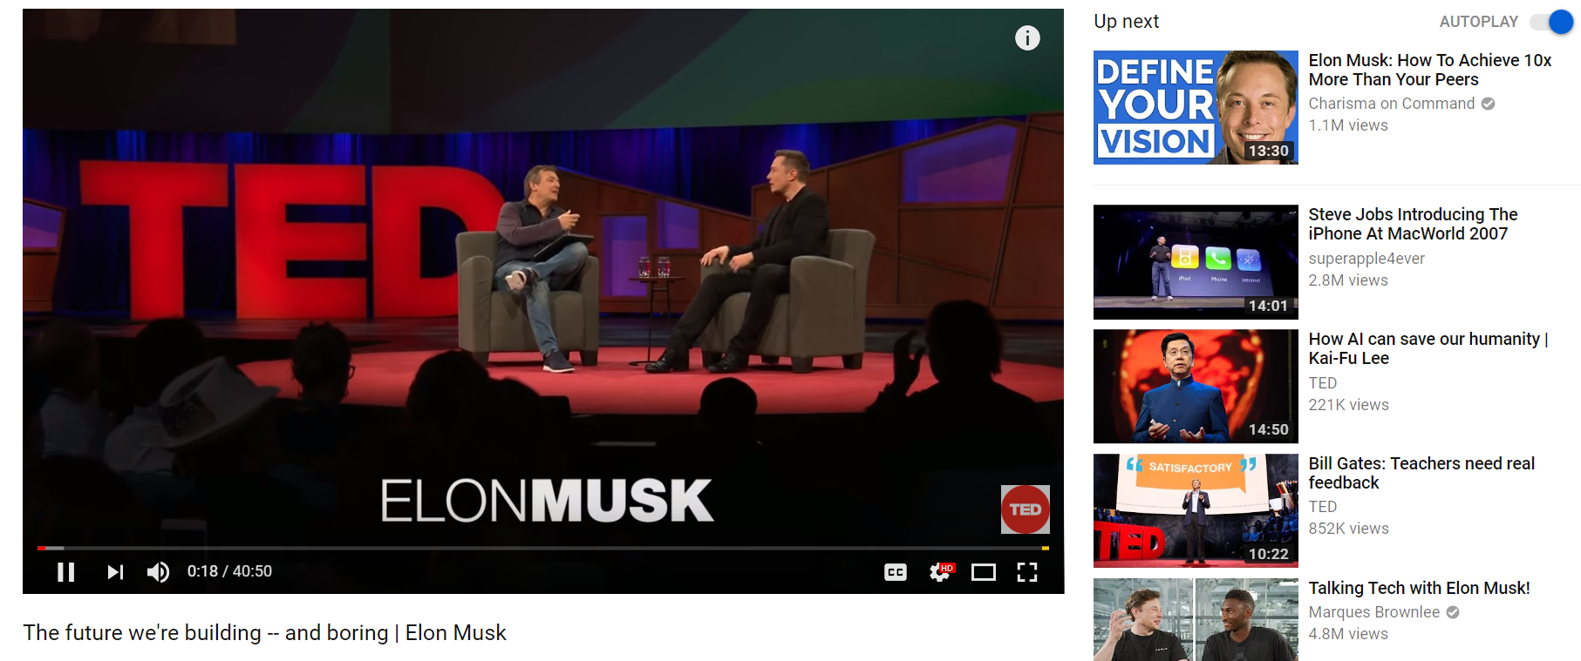

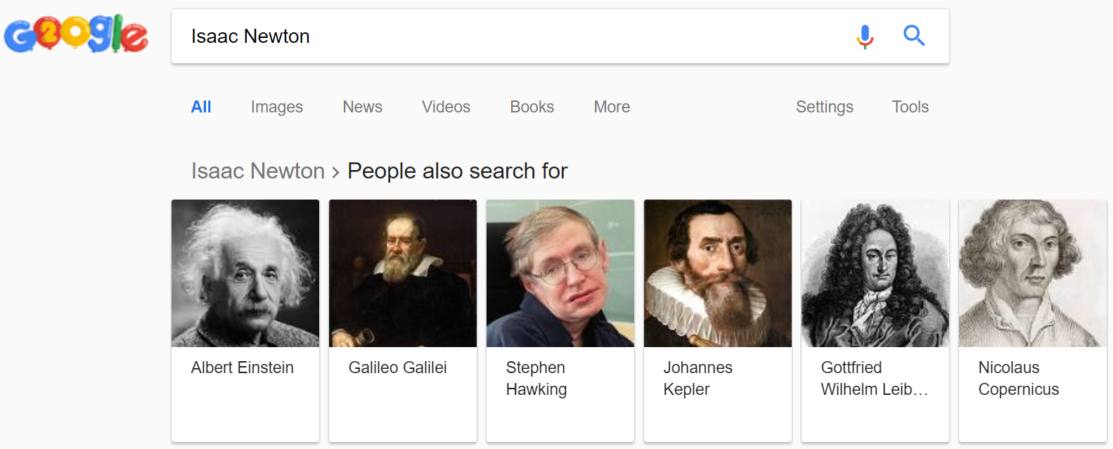
Recommender Systems
A recommender system (RS) helps users that have no sufficient competence or time to evaluate the, potentially overwhelming, number of alternatives offered by a web site.
In their simplest form, RSs recommend to their users personalized and ranked lists of items

Slide 3
The Impact of RecSys
35% of the purchases on Amazon are the result of their recommender system, according to McKinsey.
During the Chinese global shopping festival of November 11, 2016, Alibaba achieved growth of up to 20% of their conversion rate using personalized landing pages, according to Alizila.
Recommendations are responsible for 70% of the time people spend watching videos on YouTube.
75% of what people are watching on Netflix comes from recommendations, according to McKinsey
https://tryolabs.com/blog/introduction-to-recommender-systems/

Slide 4

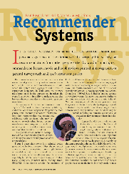

The Rise of the Recommender System
*
*2018-Estimated
Notes:
While the term was coined in early 90s
It became popular in 1997 with the important special issue of RS by Paul Resnik in Communication of the ACM

Slide 5
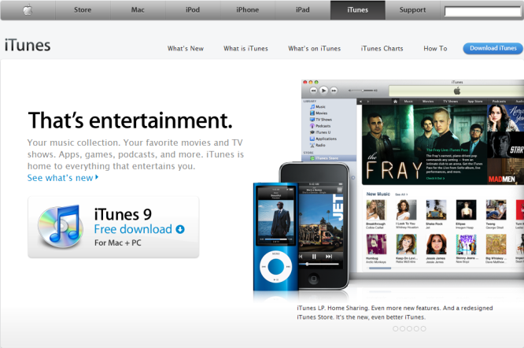

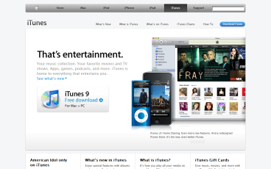
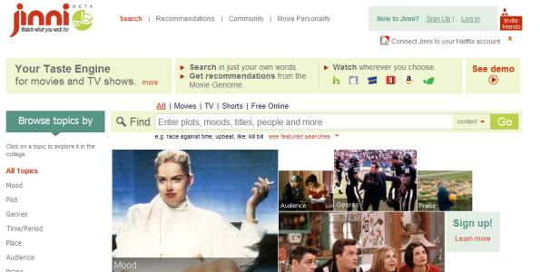
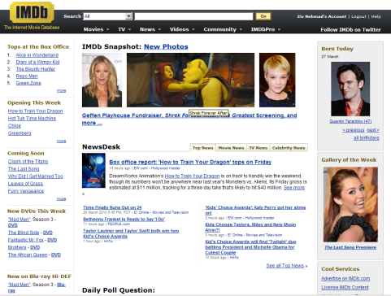



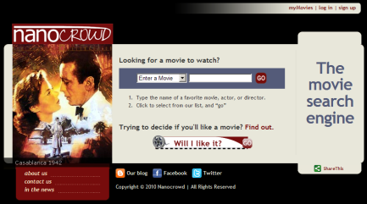
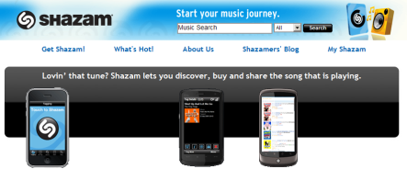
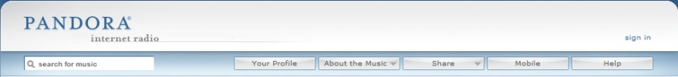




Recommendation Models
Model | Commonness | Used By:
 |  | Jinni | Taste Kid | Nanocrowd | Clerkdogs | Criticker | IMDb | Flixster | Movielens | Netflix | Shazam | Pandora | LastFM | YooChoose | Think Analytics | Itunes | Amazon
Collaborative Filtering |  | v |  |  |  | v | v | v | v | v | v |  | v | v | v | v | v
Content-Based Techniques |  | v | v | v | v |  | v |  | v |  |  | v | v | v | v |  | v
Knowledge-Based Techniques |  | v | v | v | v |  | v |  |  |  |  | v |  |  | v
Stereotype-Based Recommender Systems |  | v | v | v | v |  | v |  |  |  |  |  |  | v | v
Ontologies and Semantic Web Technologies for Recommender Systems |  | v |  | v |  |  |  |  |  |  |  | v
Community Based Recommender Systems |  | v |  | v |  | v |  |  | v | v |  |  |  | v | v
Demographic Based Recommender Systems |  |  |  |  |  |  |  |  |  | v
Context Aware Recommender Systems |  | v |  | v | v | v |  |  |  |  |  |  |  | v | v
Conversational/Critiquing Recommender Systems |  | v |  |  |  |  |  |  |  |  |  |  |  |  | v
Hybrid Techniques |  | v |  |  |  |  |  | v |  | v | v |  | v

Slide 6
Collaborative Filtering
Overview
abcd
The Idea
Trying to predict the opinion the user will have on the different items and be able to recommend the “best” items to each user based on: the user’s previous likings and the opinions of other like minded (“Similar”) users
Negative Rating
?
Positive Rating

Slide 7
Collaborative Filtering
abcd
Various Tasks
Input:
Rating Data
Event Data
Explicit Feedback (Rating, Like/Dislike)
vs.
Implicit Feedback (Viewed item page, time spend in page)
Goal:
Rating Prediction
Purchase Prediction
Top-n Recommendation
Etc.
17.10.2018

Slide 8
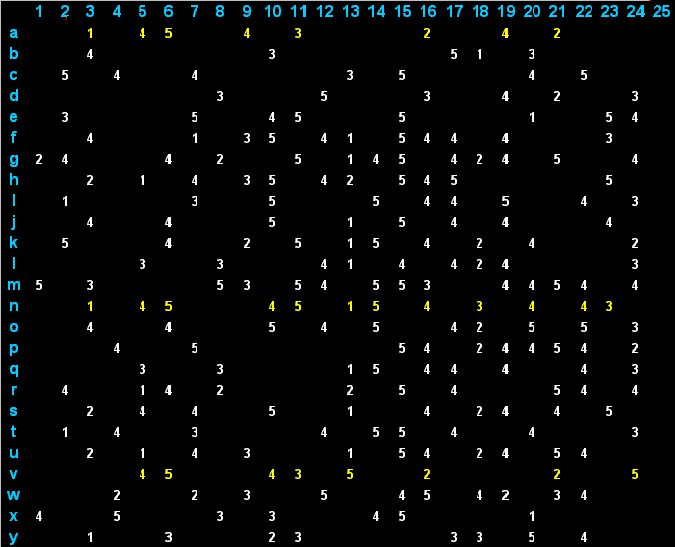
Collaborative Filtering
Rating Matrix
abcd
Example of Rating Matrix
The ratings of users and items are represented in a matrix
17.10.2018

Slide 9
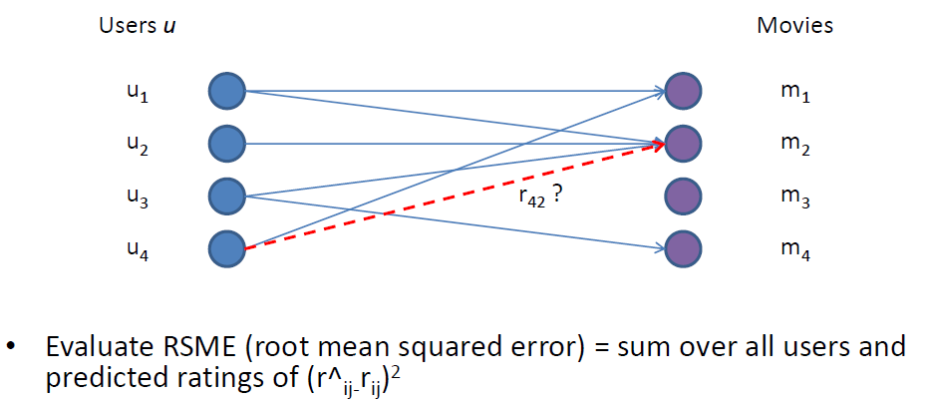
Collaborative Filtering
Rating Prediction Task
abcd
Rating Prediction
Given a set of users U that have rated some set of items M, for each rating not yet present, predict the rating r_{ij} that user u_{i} will give item m_{j}
17.10.2018

Slide 10
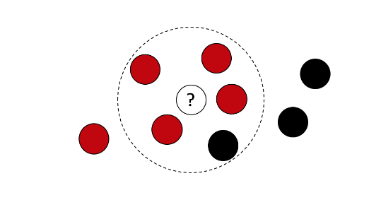
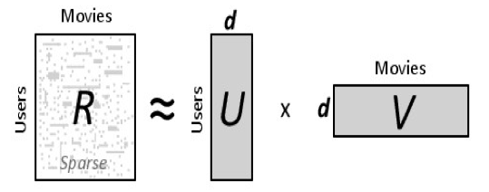
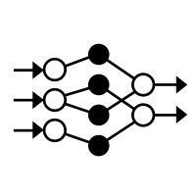
Collaborative Filtering
Techniques
Popular Techniques
Nearest Neighbor
Matrix Factorization
Deep Learning
17.10.2018

Slide 11
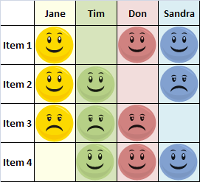
Collaborative Filtering
Approach 1: Nearest Neighbors
abcd
abcd
“People who liked this also liked…”
User-to-User
Recommendations are made by finding users with similar tastes. Jane and Tim both liked Item 2 and disliked Item 3; it seems they might have similar taste, which suggests that in general Jane agrees with Tim. This makes Item 1 a good recommendation for Tim. This approach does not scale well for millions of users.
Item to Item
Item-to-Item
Recommendations are made by finding items that have similar appeal to many users. Tom and Sandra are two users who liked both Item 1 and Item 4. That suggests that, in general, people who liked Item 4 will also like item 1, so Item 1 will be recommended to Tim. This approach is scalable to millions of users and millions of items.
User to User
17.10.2018

Slide 12
Nearest Neighbor Technique
Popular Methods
Methods
Using predefined similarity measures (such as Pearson or Hamming Distance)
Learning similarity the relations weights via optimization
17.10.2018

Slide 13
Nearest Neighbor Using predefined Similarity Measure
Current User
Users
1
1st item rate
0
Dislike
?
1
Like
0
abcd
abcd
Prediction
1
Unknown Rating
abcd
1
The prediction was made based on the nearest neighbor.
Other Users
This user did not rate the item. We will try to predict a rating according to his neighbors.
There are other users who rated the same item. We are interested in the Nearest Neighbors.
1
Items
?
Unknown
0
1
1
User Model = interaction history
0
abcd
1
Nearest Neighbors
1
We are looking for the Nearest Neighbor. The one with the lowest Hamming distance.
abcd
1
Nearest Neighbor
1
0
14th item rate
Hamming distance
5
6
6
5
4
8
17.10.2018
Notes:
Simple but very effective!!!

Slide 14
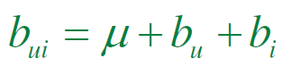
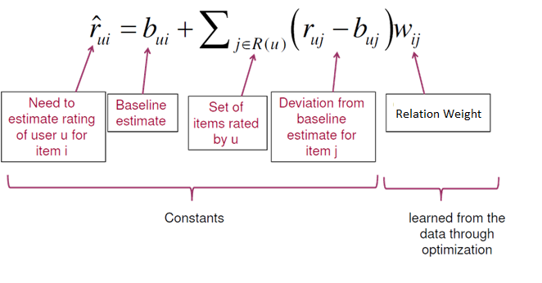

Nearest Neighbor Using optimization
abcd
A basic model
$$min \sum{{\left(r_{ui}−{\hat{r}}_{ui}\right)}^{2}}{}$$

Slide 15
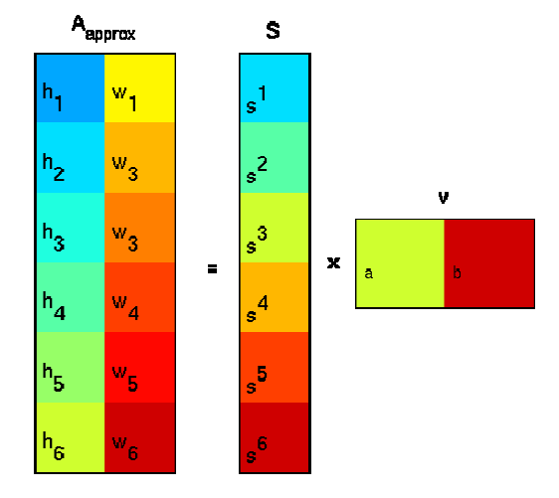
Collaborative Filtering
Approach 2: Matrix factorization
abcd
abcd
Factorization
In the Recommendation Systems field, SVD models users and items as vectors of latent features which when cross product produce the rating for the user of the item
With SVD a matrix is factored into a series of linear approximations that expose the underlying structure of the matrix.
The goal is to uncover latent features that explain observed ratings
17.10.2018
Notes:
Matrix factorization models (SVD, SVD++, and Time-aware): [41] Latent factor models approach Collaborative Filtering with the holistic goal to uncover latent features that explain observed ratings; this type of methods includes SVD (Singular Value Decomposition), SVD++ and Time-aware factor methods. SVD models users and items as vectors of latent features which when cross product produce the rating for the user of the item. In SVD we face an optimization problem consisting of finding the best values for each user and item vectors. SVD++ is shown to offer accuracy superior to SVD. An improvement is achieved by incorporating implicit feedback into the SVD model, especially for users that provides more implicit data than explicit one. Time-aware factor models temporal effects such as changes in user biases, item biases and user preference over time since these may change. These models can also be extended to consider just Boolean ratings, such as purchased/not-purchased, or visited/not-visited, that may be easier to collect in real scenarios.

Slide 16

The Netflix Prize
Started on Oct. 2006
$1,000,000 Grand Prize
Training dataset: 100 million ratings (1,2,3,4,5 stars) from 480K customers on 18 K movies.
Qualifying set (2,817,131 ratings) consisting of:
Test set (1,408,789 ratings), used to determine winners
Quiz set (1,408,342 ratings), used to calculate leaderboard scores
Goal:
Improve the Netflix existing algorithm by at least 10%
Reduce RMSE From 0.9525 to RMSE<0.8572

Slide 17
Three Years Later …

Slide 18
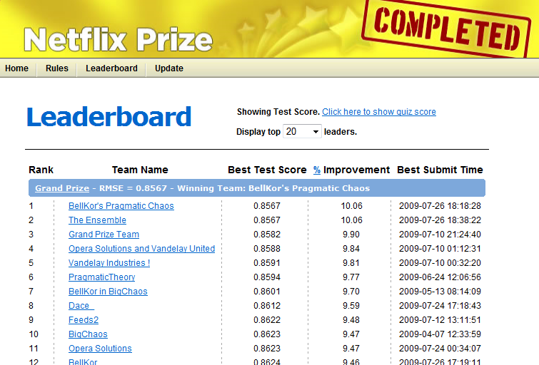
20 min later

Slide 19
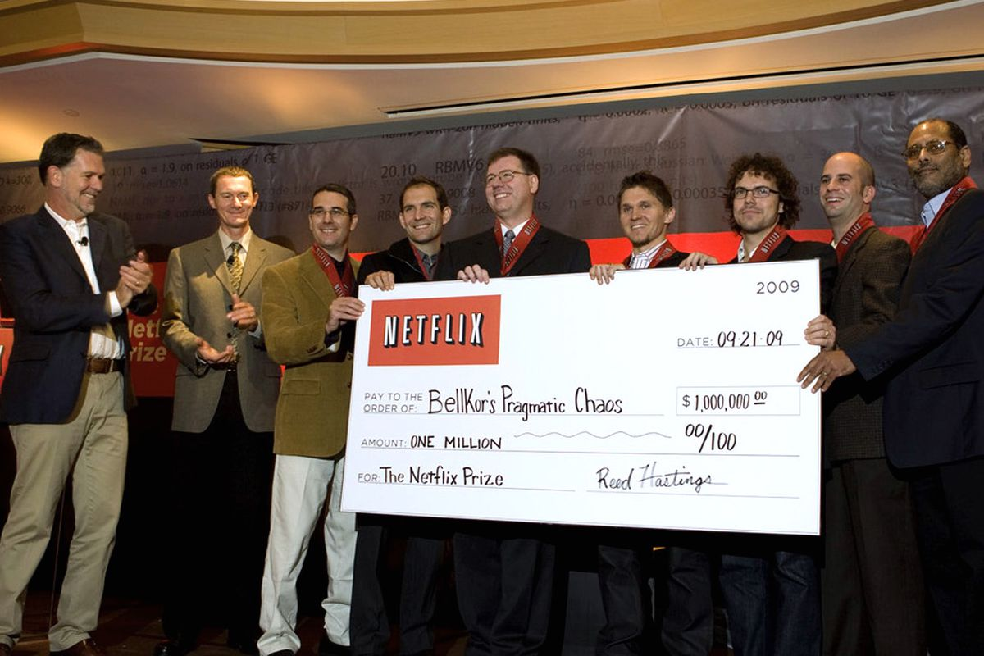
The Prize Goes To …
Once a team succeeded to improve the RMSE by 10%, the jury issue a last call, giving all teams 30 days to send their submissions.
On July 25, 2009 the team "The Ensemble” achieved a 10.09% improvement.
After some dispute …

Slide 20
Lessons Learned from the Netflix Prize
Competition is an excellent way for companies to:
Outsource their challenges
Get PR.
Hire top talent
SVD has become the method-of-choice in CF.
Ensemble is crucial for winning.
Regularization is important for alleviating over-fitting.
When an abundant training data is given, content features (e.g. genre and actors) found to be useless.
Methods that were developed during competitions are not always useful for real systems.

Slide 21
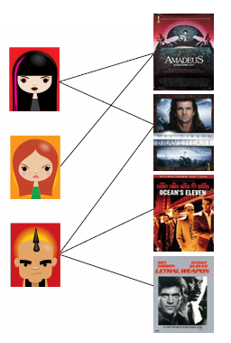
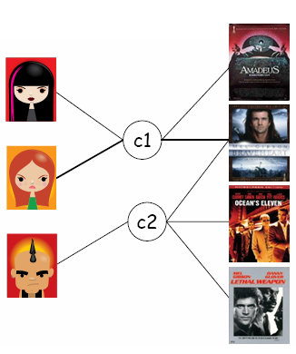
Latent Factor Models Example
Users & Ratings
Latent Concepts or Factors
abcd
Hidden Concept
SVD reveals hidden connections and its strength
abcd
SVD
SVD Process
abcd
SVD
User Rating
17.10.2018

Slide 22


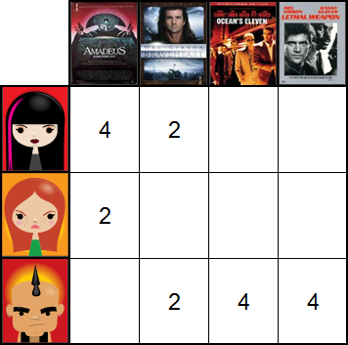
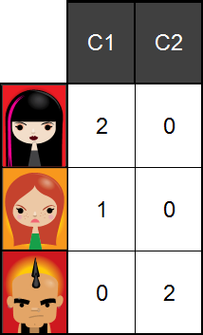
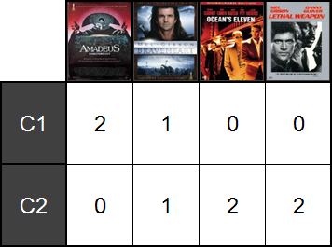
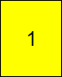
Latent Factor Models Example
Users & Ratings
Latent Concepts or Factors
abcd
Recommendation
SVD revealed a movie this user might like!
17.10.2018

Slide 23
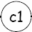
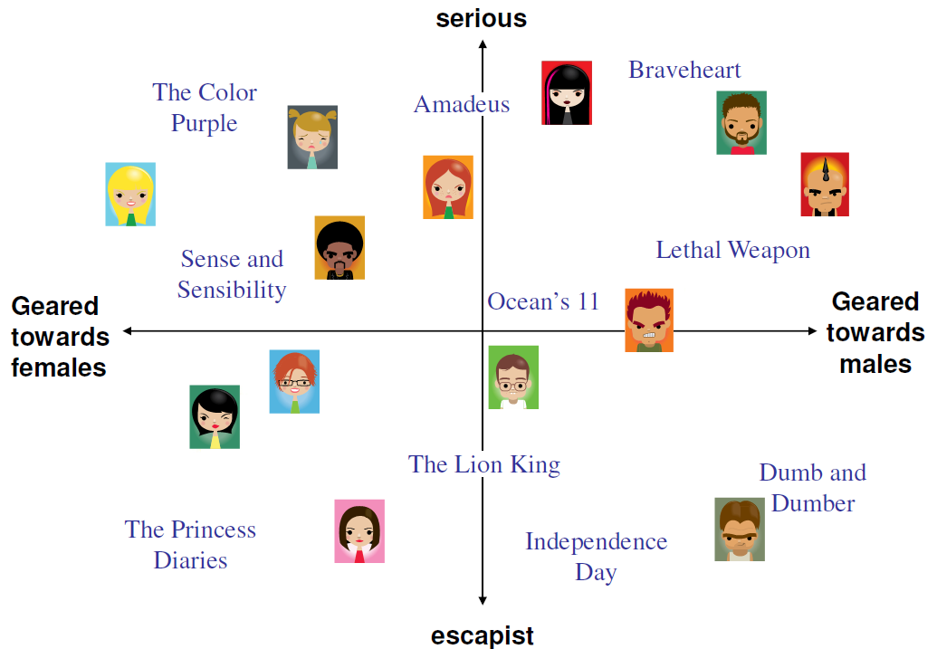
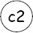
Latent Factor Models Concept space
17.10.2018

Slide 24
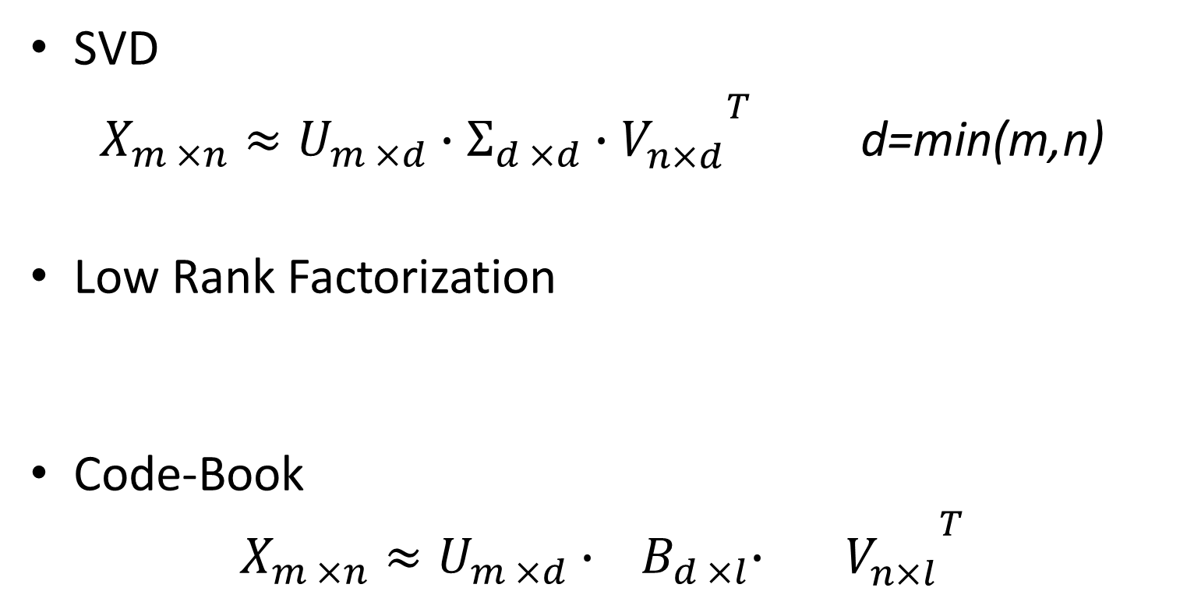

Popular Factorization
SVD
$X_{m ×n}≈U_{m ×d}∙Σ_{d ×d}∙{V_{n×d}^{}}^{T}$ d=min(m,n)
Low Rank Factorization
Code-Book
$$X_{m ×n}≈U_{m ×d}∙{ B}_{d ×l}∙{{ V}_{n×l}^{}}^{T}$$
diagonal matrix where singular values indicate the factor importance
$$X_{m ×n}≈U_{m ×d}∙{V_{n×d}^{}}^{T}$$
Permutation Matrix

Slide 25
Estimate latent factors through optimization
Decision Variables:
Matrices U, V
Goal function:
Minimize some loss function on available entries in the training rating matrix
Most frequently MSE is used:
Easy to optimize
A proxy to other predictive performance measures
Methods:
e.g. use stochastic gradient descent

Slide 26

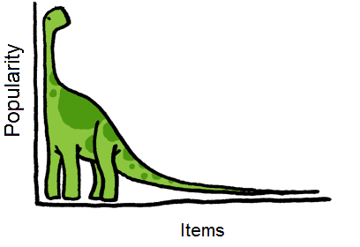
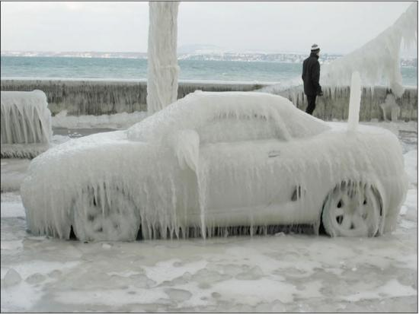
Three Related Issues
Sparseness
Long Tail
many items in the Long Tail have only few ratings
Cold Start
System cannot draw any inferences for users or items about which it has not yet gathered sufficient data

Slide 27
Transfer Learning (TL)
Transfer previously learned “knowledge” to new domains, making them capable of learning a model from very few training examples.
Traditional Machine Learning
Transfer learning

Slide 28





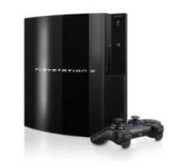



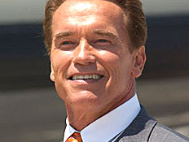

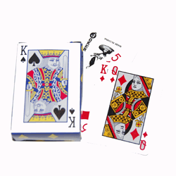

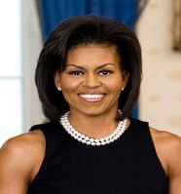
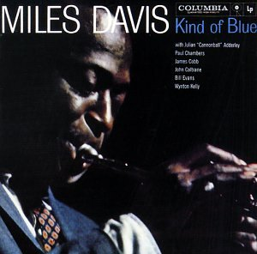
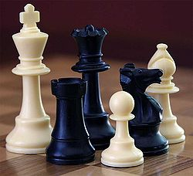
Transfer Learning Share-Nothing
Games
Music

Slide 29
Transfer Learning Share-Nothing
Games
Music
Best seller
Best seller
Trendy
Trendy
Classic
Classic

Slide 30
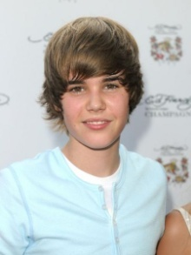
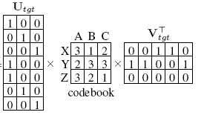
$$X_{m ×n}≈U_{m ×d}∙{ B}_{d ×l}∙{{ V}_{n×l}^{}}^{T}$$
Users
Items
e | d | c | b | a
1 | 3 | 3 | 1 | ? | 1
3 | ? | 2 | 3 | 3 | 2
? | 3 | ? | 2 | 2 | 3
? | ? | 3 | 1 | 1 | 4
1 | 3 | ? | ? | 1 | 5
3 | 2 | 2 | ? | 3 | 6
2 | 3 | 3 | 2 | ? | 7
Rating Matrix

Slide 31
$$X_{m ×n}≈U_{m ×d}∙{ B}_{d ×l}∙{{ V}_{n×l}^{}}^{T}$$
Users
Items
e | d | c | b | a
1 | 3 | 3 | 1 | 1 | 1
3 | ? | 2 | 3 | 3 | 2
? | 3 | ? | 2 | 2 | 3
? | ? | 3 | 1 | 1 | 4
1 | 3 | ? | ? | 1 | 5
3 | 2 | 2 | ? | 3 | 6
2 | 3 | 3 | 2 | ? | 7
Rating Matrix

Slide 32
$$X_{m ×n}≈U_{m ×d}∙{ B}_{d ×l}∙{{ V}_{n×l}^{}}^{T}$$
Users
Items
e | d | c | b | a
1 | 3 | 3 | 1 | 1 | 1
3 | ? | 2 | 3 | 3 | 2
? | 3 | ? | 2 | 2 | 3
? | ? | 3 | 1 | 1 | 4
1 | 3 | ? | ? | 1 | 5
3 | 2 | 2 | ? | 3 | 6
2 | 3 | 3 | 2 | ? | 7
Rating Matrix

Slide 33
$$X_{m ×n}≈U_{m ×d}∙{ B}_{d ×l}∙{{ V}_{n×l}^{}}^{T}$$
Users
Items
e | d | c | b | a
1 | 3 | 3 | 1 | 1 | 1
3 | 2 | 2 | 3 | 3 | 2
? | 3 | ? | 2 | 2 | 3
? | ? | 3 | 1 | 1 | 4
1 | 3 | ? | ? | 1 | 5
3 | 2 | 2 | ? | 3 | 6
2 | 3 | 3 | 2 | ? | 7
Rating Matrix

Slide 34
Codebook Transfer
Assumption: related domains share similar cluster level rating patterns.
f | e | d | c | b | a
? | 2 | 3 | 3 | 3 | 2 | 1
1 | ? | 2 | 2 | 1 | 3 | 2
1 | 3 | 2 | ? | 1 | 3 | 3
2 | 3 | 1 | 1 | 2 | ? | 4
3 | 2 | 3 | 3 | 3 | 2 | 5
2 | 3 | ? | 1 | 2 | 3 | 6
d | c | f | b | e | a
2 | 2 | 1 | 1 | ? | 3 | 2
2 | ? | 1 | 1 | 3 | 3 | 3
3 | 3 | ? | 3 | 2 | 2 | 1
3 | 3 | 3 | 3 | 2 | 2 | 5
1 | 1 | 2 | 2 | 3 | ? | 4
? | 1 | 2 | 2 | 3 | 3 | 6
items
users
C | B | A
2 | 1 | 3 | X
3 | 3 | 2 | Y
1 | 2 | 3 | Z
Source domain (music)
After permutation
e | d | c | b | c
1 | 3 | 3 | 1 | ? | 1
3 | ? | 2 | 3 | 3 | 2
? | 3 | ? | 2 | 2 | 3
? | ? | 3 | 1 | 1 | 4
1 | 3 | ? | ? | 1 | 5
3 | 2 | 2 | ? | 3 | 6
2 | 3 | 3 | 2 | ? | 7
e | b | a | d | c
1 | 1 | ? | 3 | 3 | 1
? | 1 | 1 | ? | 3 | 4
1 | ? | 1 | 3 | ? | 5
3 | 3 | 3 | ? | 2 | 2
3 | ? | 3 | 2 | 2 | 6
? | 2 | 2 | 3 | ? | 3
2 | 2 | ? | 3 | 3 | 7
items
users
B | A
1 | 3 | X
3 | 2 | Y
2 | 3 | Z
Target domain (games)
After permutation

Slide 35
Why does it make sense?
The rows/columns in the code-book matrix represents the users’/items’ rating distribution:
J | I | H | G | F | E | D | C | B | A
2 | 2 | 3 | 1 | 1 | 2 | 2 | 1 | 1 | 3 | a
3 | 3 | 5 | 4 | 5 | 5 | 5 | 4 | 4 | 2 | b
1 | 5 | 2 | 4 | 3 | 4 | 2 | 3 | 5 | 1 | c
1 | 4 | 4 | 3 | 2 | 2 | 3 | 2 | 1 | 2 | d
1 | 2 | 2 | 3 | 4 | 3 | 3 | 5 | 1 | 3 | e
2 | 3 | 2 | 1 | 2 | 1 | 3 | 1 | 5 | 3 | f
Less training instances are required to match users/items to existing patterns than rediscover these patterns

Slide 36
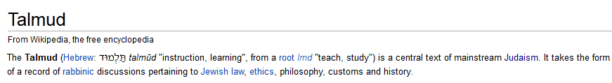

TALMUD
TrAnsfer Learning from MUltiple Domains
Extends the codebook transfer concept to support:
Multiple source domains with varying levels of relevance.

Slide 37
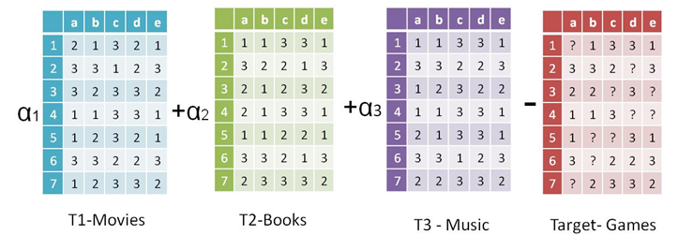
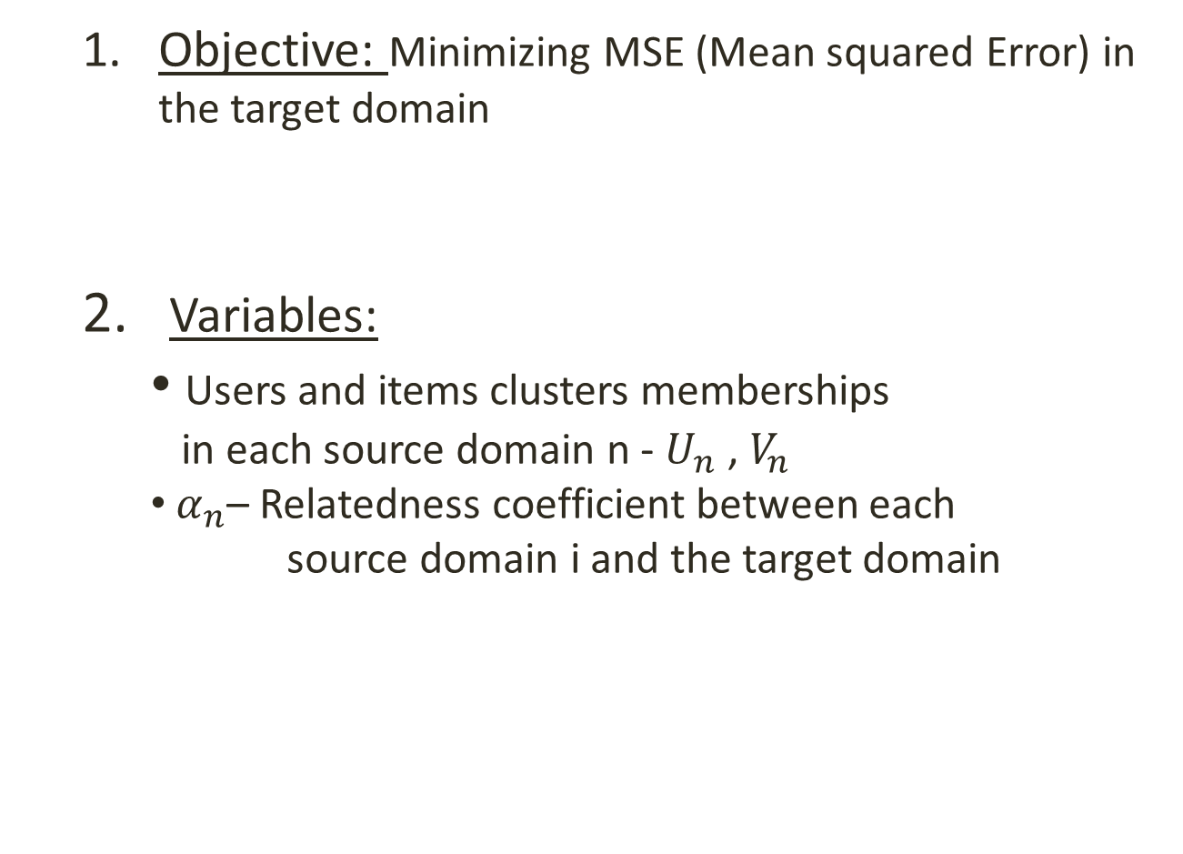
TALMUD-Problem Definition
Objective: Minimizing MSE (Mean squared Error) in the target domain
2. Variables:
Users and items clusters memberships
in each source domain n - $U_{n}$ , $V_{n}$
$α_{n}$– Relatedness coefficient between each source domain i and the target domain
Min
37

Slide 38
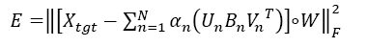
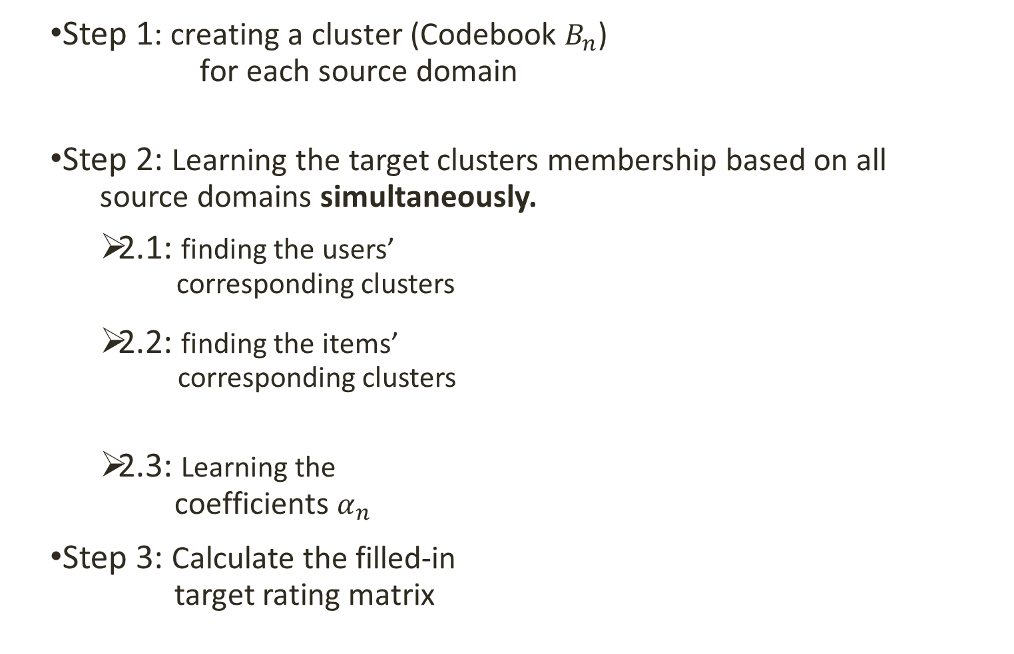
The TALMUD Algorithm
Step 1: creating a cluster (Codebook $B_{n}$)
for each source domain
Step 2: Learning the target clusters membership based on all source domains simultaneously.
2.1: finding the users’
corresponding clusters
2.2: finding the items’
corresponding clusters
2.3: Learning the
coefficients $α_{n}$
Step 3: Calculate the filled-in
target rating matrix
Notes:
This will be done by developing an algorithm that will integrate the rating patterns of all the source domain into one model that will enable to predict the target matrix missing values.

Slide 39
Forward Selection of Sources
Adding sources gradually-
Begins with an empty set of sources
Examine the addition of each source
Add the source that improves the model the most
Wrapper approach is used to decide when to stop.
Retrain using the entire dataset with the selected sources
1)
2)
Data
Training
Validation
Test
Training
Test

Slide 40
Datasets
Public Dataset (Source Domain)
Netfilx (Movies)
Jester (Jokes)
MovieLense (Movies)
Target Domain
Music loads
Games loads
BookCrossing (Books)

Slide 41
Compared Methods
CB (George and Merugu, 2005) Codebook based factorization for a single domain
SVD (Koren et al., 2009) - A single domain algorithm that fills the matrix by finding the users’ and items’ latent factors.
CBT (Li et al. 2009a), which learns only from one source domain.
RMGM (Li et al., 2009b) a multi-tasking TL method that aims to fill missing values in multiple domains.
TALMUD

Slide 42
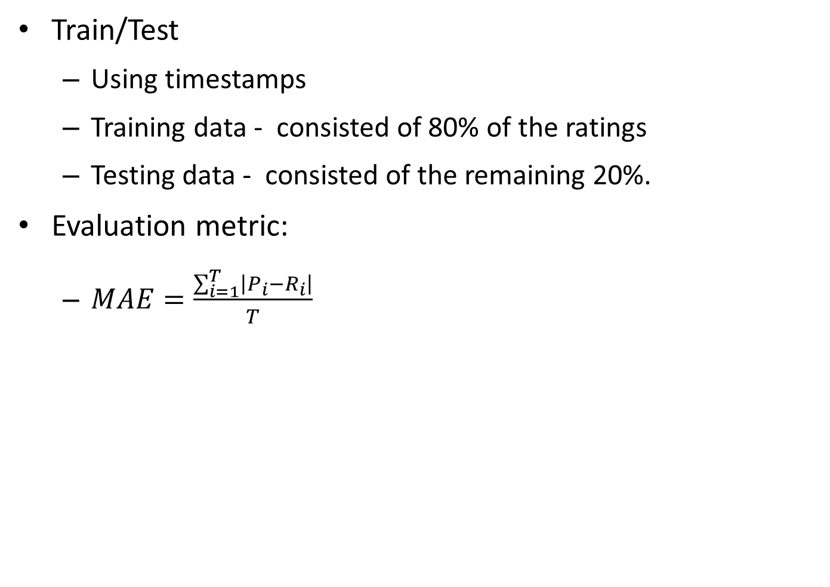
Evaluation Procedure
Train/Test
Using timestamps
Training data - consisted of 80% of the ratings
Testing data - consisted of the remaining 20%.
Evaluation metric:
$MAE=\frac{\sum_{i=1}^{T}{\left|P_{i}−R_{i}\right|}}{T}$

Slide 43
Comparison Results

Slide 44
Curse of Sources
Too many sources leads to over-fitting.
Not all given source domains should be used.

Slide 45
Converge in Practice
Talmud converges to a local minimum in a few iterations;
In our empirical tests it usually takes less than ten iterations

Slide 46
and then deep learning comes

Slide 47
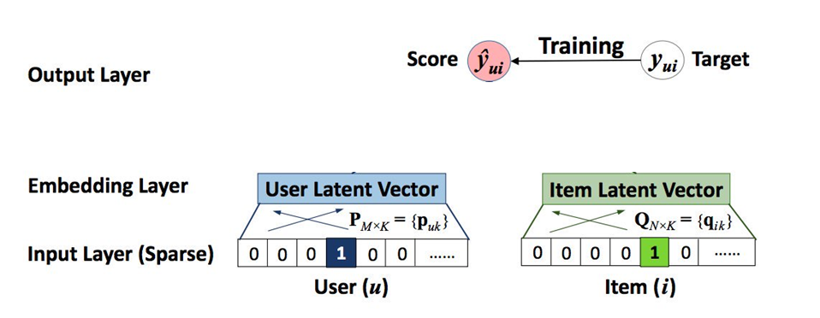
SVD Implementation
dot product

Slide 48
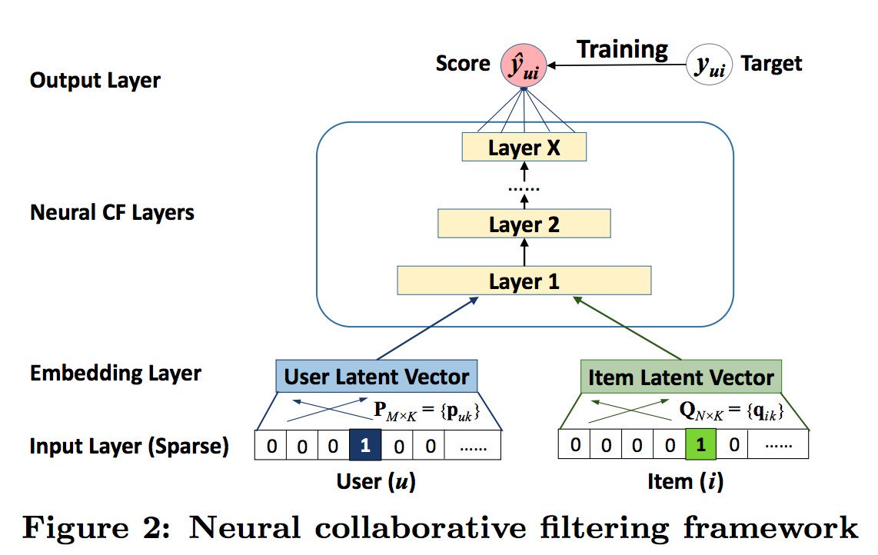
Deep Implementation

Slide 49
How to win Netflix Prize with a few lines of code:
movie_count = 17771
user_count = 2649430
model_left = Sequential()
model_left.add(Embedding(movie_count, 60, input_length=1))
model_right = Sequential()
model_right.add(Embedding(user_count, 20, input_length=1))
model = Sequential()
model.add(Merge([model_left, model_right], mode='concat'))
model.add(Flatten())
model.add(Dense(64))
model.add(Activation('sigmoid'))
model.add(Dense(64))
model.add(Activation('sigmoid'))
model.add(Dense(64))
model.add(Activation('sigmoid'))
model.add(Dense(1))
model.compile(loss='mean_squared_error', optimizer='adadelta')
model.fit([tr[:,0].reshape((L,1)), tr[:,1].reshape((L,1))], tr[:,2].reshape((L,1)), batch_size=24000, nb_epoch=42, validation_data=([ ts[:,0].reshape((M,1)), ts[:,1].reshape((M,1))], ts[:,2].reshape((M,1))))

Slide 50
Item2Vec: Item Embedding
Represent each item with a low-dimensional vector
Item similarity = vector similarity
Learned from users’ sessions.
Inspired by Word2Vec
Words = Items
Sentences = Users’ Sessions

Slide 51
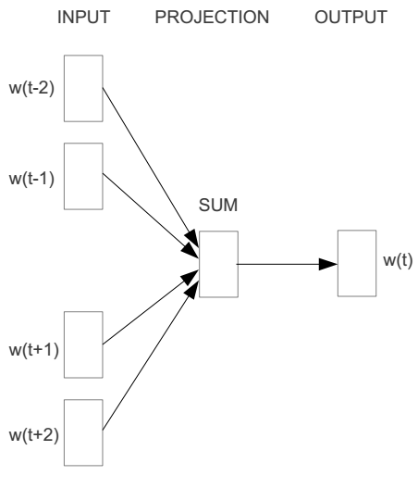
Continuous Bag of Items
E.g. given a user’s session of (I₁, I₂, I₃,I₄,I₅)
Window size = 2
I1
I2
I3
I4
I5

Slide 52



We must learn W and W’
Input layer
0
1
0
I2
0
$$W_{V×N}$$
Hidden layer
Output layer
0
0
0
0
0
0
V-dim
…
0
0
$${W′}_{N×V}$$
0
0
I2
0
0
0
0
1
0
$$W_{V×N}$$
N-dim
…
V-dim
1
0
I4
0
0
N is the size of embedding vector
0
0
V-dim
…
0
V is the size of product catalog

Slide 53





$$W_{V×N}^{T} ×x_{I1}=v_{I1}$$
0.1 | 2.4 | 1.6 | 1.8 | 0.5 | 0.9 | … | … | … | 3.2
0.5 | 2.6 | 1.4 | 2.9 | 1.5 | 3.6 | … | … | … | 6.1
… | … | … | … | … | … | … | … | … | …
… | … | … | … | … | … | … | … | … | …
0.6 | 1.8 | 2.7 | 1.9 | 2.4 | 2.0 | … | … | … | 1.2
0
2.4
2.6
…
…
1.8
Input layer
1
$$×$$
0
$$=$$
0
0
1
0
0
0
x_{I2}
0
0
Output layer
0
0
0
$$W_{V×N}^{T}×x_{I2}=v_{I2}$$
…
0
0
0
0
0
V-dim
…
0
0
0
+
0
I3
0
0
0
0
$$W_{V×N}^{T}×x_{I4}=v_{I4}$$
1
0
…
V-dim
1
Hidden layer
0
x_{I4}
0
0
N-dim
0
0
V-dim
…
0

Slide 54




Input layer
0
1
0
x_{I2}
0
Output layer
0
0
$$W_{V×N}^{T}×x_{I2}=v_{I2}$$
0
0
0.01
0.02
0.00
0.02
0.01
0.02
0.01
0.7
…
0.00
0
0
V-dim
…
0
0
$$\hat{v}=\frac{v_{I2}+v_{I4}}{2}$$
$$W_{V×N}^{′}×\hat{v}=z$$
0
$$\hat{y}=softmax(z)$$
+
0
I3
0
0
0
0
$$W_{V×N}^{T}×x_{I4}=v_{I4}$$
1
0
…
1
Hidden layer
0
x_{I4}
0
0
N-dim
0
0
V-dim
…
0
We would prefer $\hat{y}$ close to ${\hat{y}}_{I3}$

Slide 55
Some interesting results
Given that the algorithm was not exposed to item title or description:
Similarity:
Most similar item to Samsung Galaxy S7 G930V:
Samsung Galaxy S7 G930A
Samsung Galaxy S7 Edge
Item Analogy:
+ Apple iPhone 5C
- Apple iPhone 4s
+ Samsung Galaxy S5 Edge
=
Samsung Galaxy S6 Edge

Slide 56
Why Analogy Relations Are Preserved?
Other Items in the Session
Target Item | Prepaid Micro Sim | Prepaid Nano Sim | Samsung Charger Cable | Apple Earpods
iPhone 5 | 0 | 1 | 0 | 1
iPhone 4 | 1 | 0 | 0 | 1
Galaxy S5 | 1 | 0 | 1 | 0
Galaxy S6 | 0 | 1 | 1 | 0
+
-
+
=

Slide 57

Beyond Accuracy: Future Trends in RecSys
Diversity & Serendipity
Incorporating price in RecSys models
Explainable RecSys
Counteract the effect of the existing RecSys and isolate the organic browsing of the users
Knowledge-based RecSys

